Slide 1


Spatial Analysis for Beginners
<Your name, Role>
1/16/2018
© 2017 Alteryx, Inc.

Slide 2
Agenda
Upcoming Trainings
Workflow Background
Designer Training
Support
Notes:
NOTE: Adjust the agenda to match your meeting goals.

Slide 3
Upcoming Virtual Trainings – Every Tuesday @10AM PST
<Current Month>
Date - Upcoming training name 1
Date - Upcoming training name 2
Date - Upcoming training name 3
Date - Upcoming training name 4
<Next Month>
Date - Upcoming training name 1
Date - Upcoming training name 2
Date - Upcoming training name 3
Date - Upcoming training name 4
Visit http://www.alteryx.com/virtual-training for past and upcoming trainings

Slide 4

Welcome to the Alteryx Community!
Find answers quickly with enhanced search and content recommendations
Create valuable connections with peers and industry experts
Submit your bright ideas to help us improve our products
Earn reputation and rewards for your contributions
Share your knowledge with the community
Read insightful blog posts by data gurus
Join today: http://community.alteryx.com
Notes:
At Alteryx, we're extremely passionate about empowering analysts to deliver deeper insights in hours, not weeks, with intuitive workflows. With that in mind, we've designed the Alteryx Community to be the place to connect with data blending and advanced analytics experts to discover new solutions to complex challenges, contribute fresh ideas, and gain valuable perspective on the industry:
Join today: http://community.alteryx.com

Slide 5
Background for Today’s Training

Slide 6
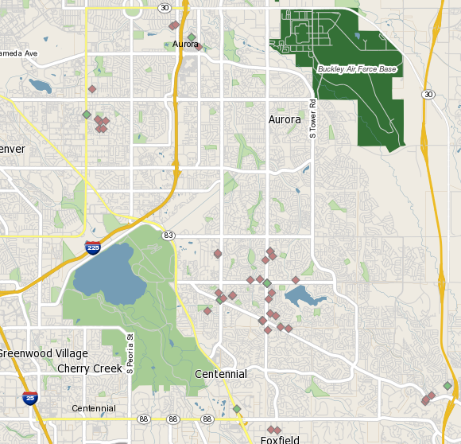
Use Case
Issue:
Measuring customer distance to a store location in both drive mileage and drive time can be time intensive
Other solutions require custom coding
Goals:
Find customers within 2.5 minutes if any given store
Find customers (if more than 2.5 min away), within a mile walk

Slide 7
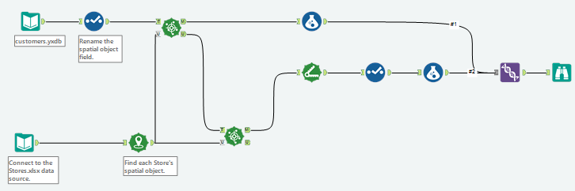






Key Concepts
Processes Covered
Generating spatial points
Measuring distance between locations
Tools Used
Input Data
Distance
Create Points
Find Nearest
Formula
Union

Slide 8
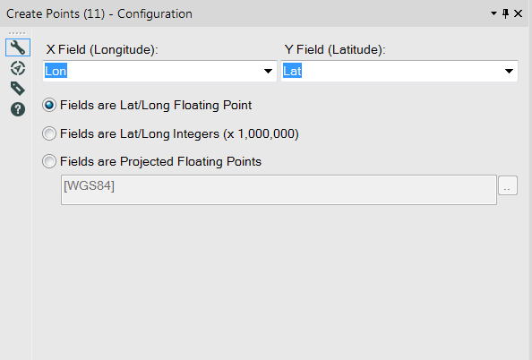
Create Points Tool
Convert lon/lat fields into a spatial object point
Choose what format the lon/lat appear in:
Floating point (most common)
-105.24611 , 40.036617
Integers
-10524611 , 40036617
Projected floating points
-11715954.616441, 4843772.952452

Slide 9
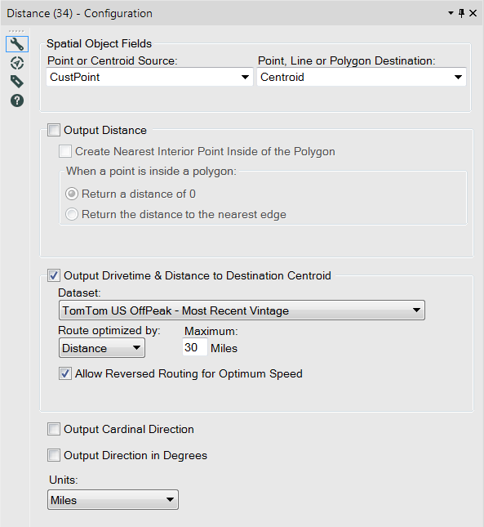
Distance Tool
Choose two points to calculate a distance
Output radial distance
Output drive distance and drive time
Reverse routing available if there are fewer destination points than source points
Output direction from source to destinations
Cardinal direction
Direction in degrees
Set units of distance

Slide 10
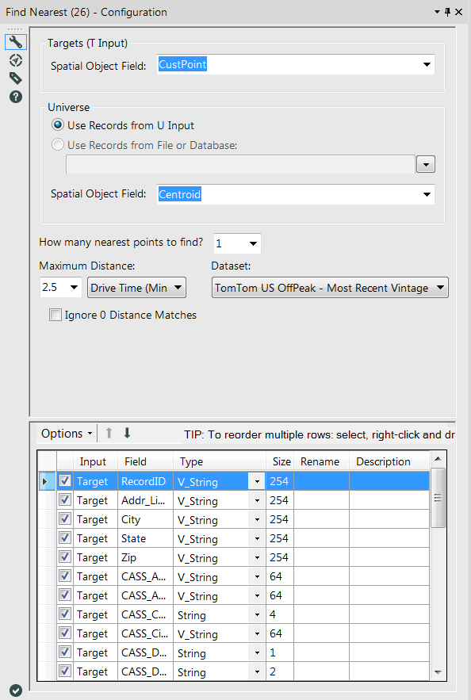
Find Nearest Tool
Target
Analysis on point or centroid
Universe
Dataset to match to the target field
Specify how many universe objects to match to a target value
Choose different methods
Radial distance (Miles, KMs)
Drive Distance (Miles, KMs)
Drive Time

Slide 11
Alteryx Designer Training

Slide 12
Support

Slide 13
Support Resources
Alteryx Community
Community.Alteryx.com
Training Resources
http://www.alteryx.com/product-training
Technical support
Email: support@alteryx.com
Live Chat: http://www.alteryx.com/support
Phone: 1 888 255 1207

Slide 14
Please Let Us Know How We Did!
You will be directed to a survey after this Webinar completes.
Please take a moment and let us know how we did. Thanks!

Slide 15
Thank You!

